Slide 1



Rethinking Energy-Performance Trade-Off in Mobile Web Page Loading
Duc Hoang Bui, Yunxin Liu, Hyosu Kim,
Insik Shin, Feng Zhao

Slide 2
Motivation
Web browsers: high energy consumption
Core applications on smartphones
Battery-powered smartphones: limited energy
Necessary to reduce energy consumption

Slide 3
Motivation
Web browsers: high energy consumption
Core applications on smartphones
Battery-powered smartphones: limited energy
Necessary to reduce energy consumption
User experience: uncompromisable factor
1-second delay in Bing search engine results in a 2.8% drop in revenue per user [1]
“As users migrate to mobile, page load time is perhaps the most important metric we have” [2]
[1] O’Reilly Velocity Web Performance and Operations Conference, 2009
[2] Howard Mittman, VP and publisher of Condé Nast, 2015

Slide 4
Goal
Reduce energy consumption of web page loading without degrading user experience
No increase in page load time

Slide 5


Approach
Analyze architectures and behaviors of popular mobile web browsers
Chromium, Firefox, UC Browser on Android
Note: Chrome = Chromium + proprietary technologies

Slide 6
Approach
Analyze architectures and behaviors of popular mobile web browsers
Chromium, Firefox, UC Browser on Android
Note: Chrome = Chromium + proprietary technologies
Identify energy inefficiency issues

Slide 7
Approach
Analyze architectures and behaviors of popular mobile web browsers
Chromium, Firefox, UC Browser on Android
Note: Chrome = Chromium + proprietary technologies
Identify energy inefficiency issues
Develop energy saving techniques

Slide 8
Approach
Analyze architectures and behaviors of popular mobile web browsers
Chromium, Firefox, UC Browser on Android
Note: Chrome = Chromium + proprietary technologies
Identify energy inefficiency issues
Develop energy saving techniques
Evaluate on top 100 U.S. websites
Save significant system energy (e.g., 24% on average) while not increasing page load time

Slide 9
Energy inefficiency issues
Mobile browsers optimized for performance, not energy
“Direct port” from desktop versions
Maximum processing speed regardless of input data
Overhead and redundant computation
Underutilization of heterogeneous architectures
Notes:
Identified issues
High energy cost of progressive web resource processing
Unnecessary high painting rate
Underutilization of energy-efficient little cores on big.LITTLE architecture

Slide 10
Energy inefficiency issues (1/3)
High energy cost of progressive web resource processing
For each small data, the whole data rendering pipeline executed
E.g., read system calls return only 1.3 KB data on average from network
Data
Data
Data
Data
Processing
Processing
Processing
Processing
Time

Slide 11

Energy inefficiency issues (1/3)
High energy cost of progressive web resource processing
For each small data, the whole data rendering pipeline executed
E.g., read system calls return only 1.3 KB data on average from network
High inter-process communication (IPC) overhead
Multi-process architecture browsers
The Internet
Data and control flow
Process boundary
Browser
Process
IO thread
GPU Thread
Renderer
Process
Rending Engine Main thread
Compositor
Chromium web browser architecture

Slide 12

Energy inefficiency issues (2/3)
Unnecessary high painting rate
Visible screen changes can be very small during web page loading
Painting: from models in memory to pixels on screen
Rendering
Painting
Resource
Model
Image
HTML document
Document Object Model (DOM) tree
Pixels
<html>

Slide 13
Energy inefficiency issues (2/3)
Unnecessary high painting rate
Visible screen changes can be very small during web page loading
Painting: from models in memory to pixels on screen
E.g. Loading instagram.com, containing no animation
Average 23-32 frames/s (Chromium, Firefox), fixed 60 fps on UC Browser
90% of paints generate zero visible changes on screen (in Chromium)
Off-screen paints

Slide 14
Energy inefficiency issues (3/3)
Underutilization of energy-efficient little cores on big.LITTLE architecture
Current OS scheduler schedules threads based on load instead of quality of service (QoS)
(a) Energy consumption on Samsung S5 Exynos

Slide 15
Energy inefficiency issues (3/3)
Underutilization of energy-efficient little cores on big.LITTLE architecture
Current OS scheduler schedules threads based on load instead of quality of service (QoS)
E.g. Loading instagram.com
Chromium: 89% of threads’ time on big cores
Firefox: 84% of Gecko rendering engine on big cores
(a) Energy consumption on Samsung S5 Exynos
(b) Execution time of Chromium threads

Slide 16
Energy saving techniques
Rethink energy-performance trade-off
Energy consumption: first-class citizen on smartphones
Reduce redundant computation
Adjust processing to the user-perceived content changes
Utilize energy efficiency on heterogeneous architectures
Notes:
Guidelines for web browsers
Reduce high cost of incremental resource processing
Remedy unnecessary high painting rate
Improve utilization of little cores on big.LITTLE architecture
Energy saving techniques
Network-aware Resource Processing
Adaptive Content Painting
Application-Assisted Scheduling

Slide 17
Network-aware Resource Processing
Perform batch processing of web resources
Reduce overhead on small data sizes
Trade-off: energy saving vs. delay
Large batch size: lower energy but high delay
Progressive processing: lower delay but high overhead
Progressive processing
Data
Data
Data
Data
Processing
Processing
Processing
Processing
Time
Batch processing
Data
Processing
Time

Slide 18

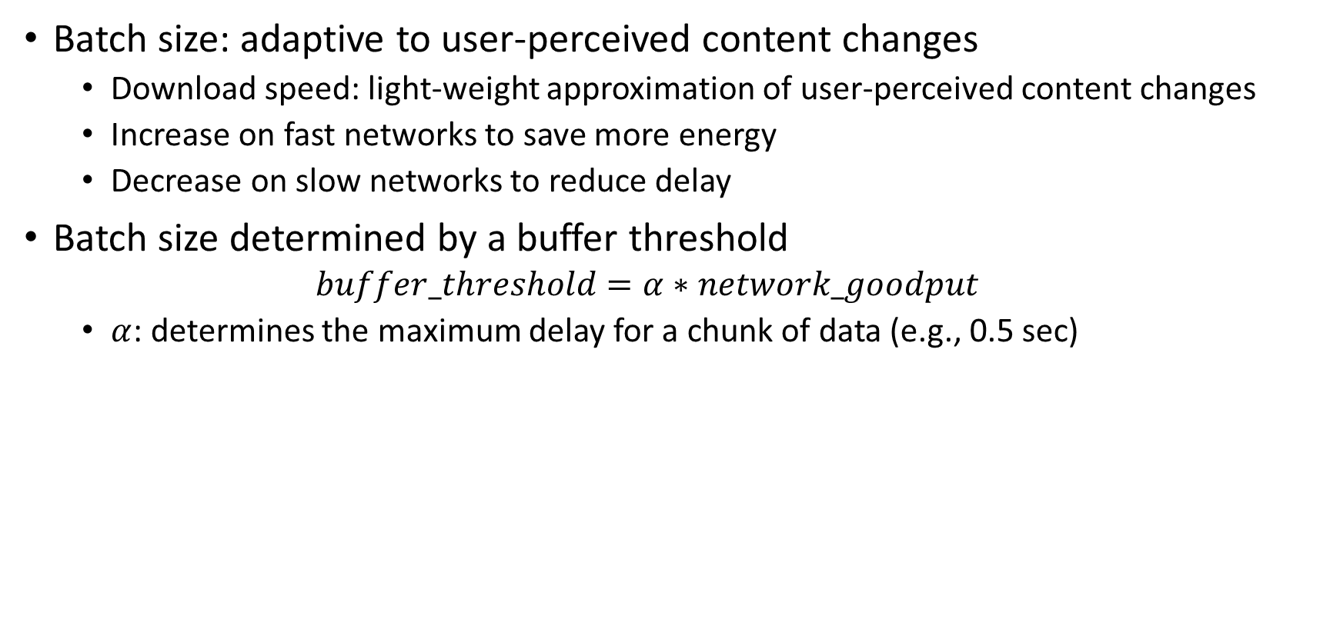
Network-aware Resource Processing
Batch size: adaptive to user-perceived content changes
Download speed: light-weight approximation of user-perceived content changes
Increase on fast networks to save more energy
Decrease on slow networks to reduce delay
Batch size determined by a buffer threshold
$$buffer_threshold=α∗network_goodput$$
$α$: determines the maximum delay for a chunk of data (e.g., 0.5 sec)
Buffer size
Buffer threshold
Batch size
$α$: maximum delay time in the buffer

Slide 19
Adaptive Content Painting
Aggregate multiple content paints
Reduce unnecessary computation of small-visible-change paints
High painting rate
Content1
Content2
Paint1
Paint2
Display1
≈
Display2
Time
Adaptive painting rate
Content1
Content2
PaintA
Display2
Time

Slide 20
Adaptive Content Painting
Aggregate multiple content paints
Reduce unnecessary computation of small-visible-change paints
Trade-off between user experience (UX) and energy
Low frame rate: less energy but worse UX
High frame rate: smoother UX but higher energy consumption

Slide 21
Adaptive Content Painting
Aggregate multiple content paints
Reduce unnecessary computation of small-visible-change paints
Trade-off between user experience (UX) and energy
Low frame rate: less energy but worse UX
High frame rate: smoother UX but higher energy consumption
paint_rate parameter: maximum content painting rate
Dynamically adapt to content changing speed
Light-weight approach
Increase linearly when content changes fast
Decrease to a minimum value when content changes slowly

Slide 22
Application-Assisted Scheduling
Better utilize little cores on big.LITTLE architecture
Leverage internals of applications for scheduling
Schedule threads according to QoS
QoS requirement: frame painting time of browser
Load-based scheduling
QoS-based scheduling
High load
QoS violated
Little cores
Big cores
Little cores
Big cores
Low load
QoS satisfied

Slide 23
Application-Assisted Scheduling
Better utilize little cores on big.LITTLE architecture
Leverage internals of applications for scheduling
Schedule threads according to QoS
QoS requirement: frame painting time of browser
Dynamic thread-to-core assignment
Move threads to big cores: when QoS about to be violated
Bring threads back to little cores: when QoS satisfied
Load-based scheduling
QoS-based scheduling
High load
QoS violated
Little cores
Big cores
Little cores
Big cores
Low load
QoS satisfied

Slide 24
Implementation
Prototype based on Chromium version 38 (16 million lines of code)
Buffered resource handler: Network-aware Resource Processing
VSync monitor: Adaptive Content Painting
Thread management module: Application-Assisted Scheduling
Disk Cache
The Internet
Data and control flow
Process boundary
Instrumented module
Browser
Process
IO thread
Network Stack
Browser Main
GPU Thread
Async Transfer Thread
Resource Handlers
VSync Monitor
Resource Dispatcher Host
Shared Resource Buffer
Command and Texture Buffer
Renderer
Process
a
Child IO Thread
Renderer Main
Resource Dispatcher
Compositor Raster Worker
Compositor
Rendering Engine
Javascript Engine

Slide 25
Evaluation
Experiment setup
Emulated testbed: repeatable experimentation
Common 3G network condition
2 Mbps download, 1 Mbps upload bandwidth, 120 ms RTT
Web Page Replay tool: record and replay pages
Data set
Top 100 websites in the U.S. by Alexa.com in May 2014
Devices
S5-E: Galaxy S5 Exynos (big.LITTLE processor)
S5-S: Galaxy S5 Snapdragon (symmetric processor)
Metric: Page load time (W3C Navigation Timing specification)
Automation tool
Two modules: on smartphone and on PC controlling Monsoon power monitor, time synchronized
Each configuration and website tested at least 5 times

Slide 26
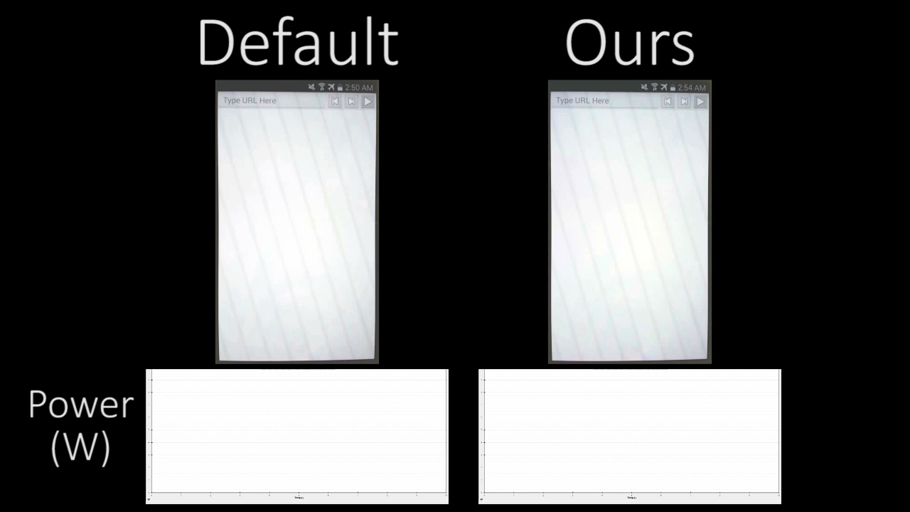
Video demo: facebook.com
cps.kaist.ac.kr/eBrowser

Slide 27
Effectiveness of all techniques
Galaxy S5 Exynos (big.LITTLE architecture)
24.4% system energy saving, including LCD screen
Page load time decreased by 0.38% (29 ms)

Slide 28
Effectiveness of all techniques
Galaxy S5 Exynos (big.LITTLE architecture)
24.4% system energy saving, including LCD screen
Page load time decreased by 0.38% (29 ms)
Galaxy S5 Snapdragon (symmetric processor)
11.7% system energy saving (without Application-Assisted Scheduling technique)
Page load time increased by only 0.01% (6.7 ms)

Slide 29
Effectiveness of each technique
Energy saving
Application-Assisted Scheduling (AAS): most effective
Network-aware Resource Processing (NRP) and Adaptive Content Painting (ACP): similar effectiveness

Slide 30
Effectiveness of each technique
Energy saving
Application-Assisted Scheduling (AAS): most effective
Network-aware Resource Processing (NRP) and Adaptive Content Painting (ACP): similar effectiveness
Page load time increase of individual technique is small
Maximum 0.76% average increase (NRP) on Galaxy S5 Snapdragon

Slide 31
User perceived experience
User study: 18 users, compare our vs. default browsers
Test 1: observe loading speed and smoothness of 10 random websites
Test 2: do real web browsing for 5 minutes

Slide 32
User perceived experience
User study: 18 users, compare our vs. default browsers
Test 1: observe loading speed and smoothness of 10 random websites
Test 2: do real web browsing for 5 minutes
Results: Minimal difference between our and default browsers
All users want to use our revised browser
72% users would always use, 28% users would use when low battery
Better
Same
User experience
Worse

Slide 33
Case study: All techniques
Significant reduction of power consumption
E.g., System power reduction: 5.3 W (Default) vs. 1.4 W (ours)
Loading infusionsoft.com

Slide 34
Case study: AAS technique
Significant increase of utilization of little cores
E.g., 25% (Default) vs. 60% (Application-Assisted Scheduling)
Loading infusionsoft.com

Slide 35
Case study: NRP and ACP techniques
Significant reduction of threads’ execution time
E.g., Chrome_ChildIO thread execution time reduced by 65% (NRP only)

Slide 36
Evaluations on other environments and browser
Evaluation | Average system energy saving (%) | Average page load time increase (%)
Fast network (20 Mbps download, 10 Mbps upload, 50 ms RTT) | 21.8 | 0.1
3G network (3G network interface used) | 22.5 | 0.4
Web page loading with cached content | 19.6 | -1.7
Firefox web browser | 10.5 | 1.7
Significant system energy saving without page load time increase
Applicable for other web browsers

Slide 37
Evaluations on other environments and browser
Evaluation | Average system energy saving (%) | Average page load time increase (%)
Fast network (20 Mbps download, 10 Mbps upload, 50 ms RTT) | 21.8 | 0.1
3G network (3G network interface used) | 22.5 | 0.4
Web page loading with cached content | 19.6 | -1.7
Firefox web browser | 10.5 | 1.7
Significant system energy saving without page load time increase
Applicable for other web browsers
Speed Index metric increased only slightly (1.8%, on average)
(Above numbers are on Galaxy S5 Exynos big.LITTLE)

Slide 38
Related work
Energy saving for mobile web browsers
Chameleon [MobiSys11]: changes color to save energy on OLED screens
Thagarajan et al. [WWW12]: measures energy and provides guidelines (e.g., avoid complex JavaScripts)
Zhu et al. [HPCA13]: uses statistical inference models
Limitations: Ignored JavaScript and dynamic contents

Slide 39
Related work
Energy saving for mobile web browsers
Chameleon [MobiSys11]: changes color to save energy on OLED screens
Thagarajan et al. [WWW12]: measures energy and provides guidelines (e.g., avoid complex JavaScripts)
Zhu et al. [HPCA13]: uses statistical inference models
Limitations: Ignored JavaScript and dynamic contents
Our work
Deal with trade-offs inside web browsers
Others focus on the characteristics of web pages (primitives, colors, network accesses)
Orthogonal with other approaches (e.g., changing color)
Ours can be integrated with others to further improve energy efficiency
Tested on real-world websites and smartphones

Slide 40
Conclusion
Identify energy inefficiency issues in mobile web browsers
Propose energy saving techniques
Network-aware Resource Processing
Adaptive Content Painting
Application-Assisted Scheduling
Implement on popular mobile web browsers (Chromium and Firefox for Android) on commercial smartphones (Samsung Galaxy S5 phones)
Evaluate on top 100 U.S. websites: save significant system energy while not increasing page load time
24.4% system energy saving while decreasing 0.38% page load time on a big.LITTLE phone

Slide 41


Slide 42
Case study: AAS technique
Significant increase of little cores utilization on big.LITTLE architecture
E.g., 25% (Default) vs. 60% (Application-Assisted Scheduling)
Decrease of load on big cores
Default
Ours
Loading infusionsoft.com

